Slide 1
MeetMeet

Slide 2
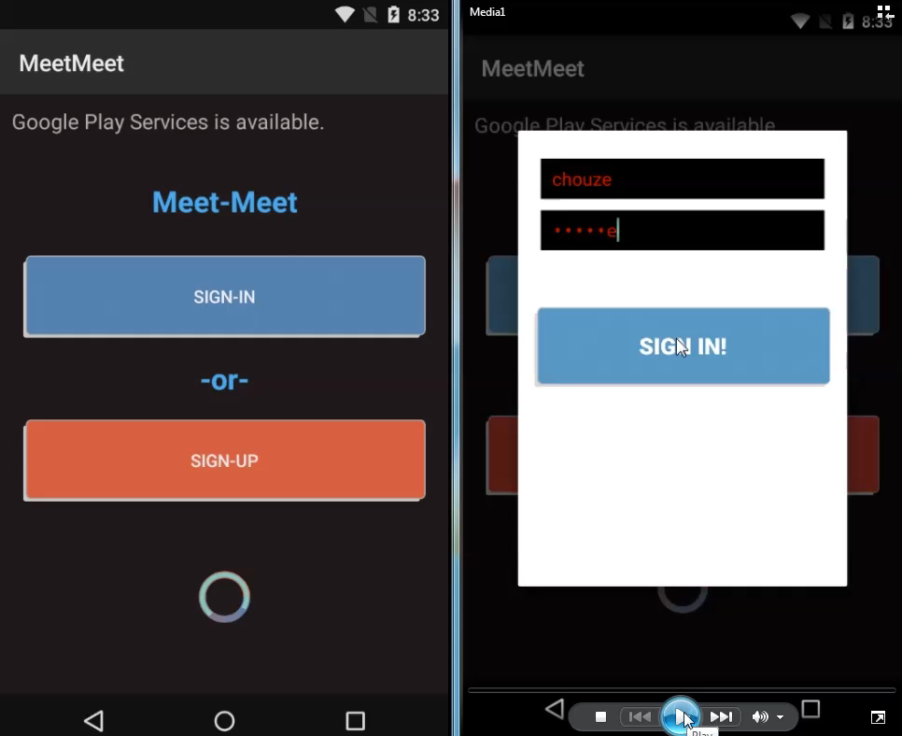
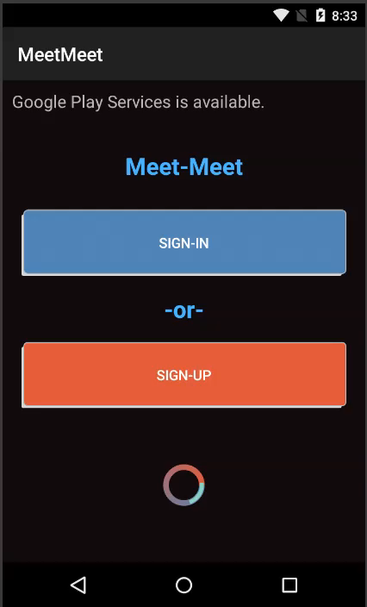
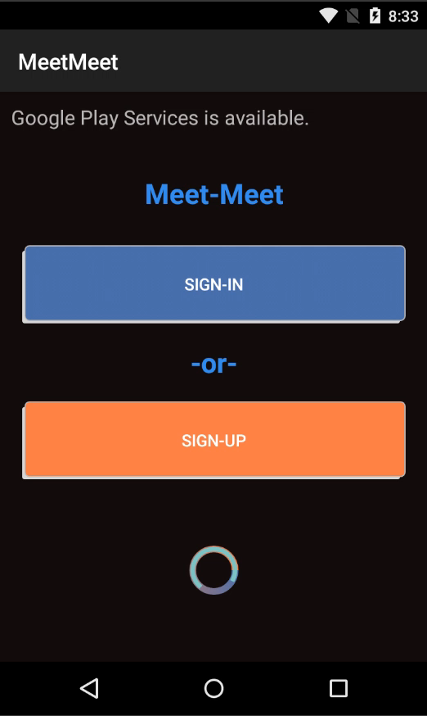

Slide 3
Profiles
Users can input their gender and a biography describing themselves
Users can rate each other positively or negatively
Users can see the ratings of other users
Because users are in close proximity to each other, we avoided adding some personal information, such as profile pictures.

Slide 4
Geolocation
Users can find other users within a 5 mile radius of themselves
The operation was optimized by first finding a bounding box, and excluding any profiles not within the box
The Great-circle distance calculation was used to further refine the results down to those within 5 miles

Slide 5
Messaging
We using Google Cloud Messaging for pushing notifications to the user’s device
SQLite was used to store the messages on the user’s device
Users can block other users if they feel offended or threatened

Slide 6
Server
Amazon Web Services free tier of server was used to host our service
Node.js was used for the webapi
MySQL was used for the database to store user information

Slide 7
Groups
Groups were added to allow users to meet in a safer environment
Groups are formed when two a request from an ungrouped user is accepted by another ungrouped user
Groups do not have maximum size, you can add as many people as you want!
Group members can send messages to all the other members

Slide 8
GUI

Slide 9
IDE
Xamarin was used so that we could more easily create a cross platform app, although we weren’t able to reach that goal
It allowed us to code in C# rather than Java

